Slide 1
Fundamentals of Programming
Introduction to Computers, Programs, and C++

Slide 2
Computer
What is?
A computer is an electronic device that stores and processes data
Data
In computing, data is the information that has been translated into a form that is efficient for movement or processing
Computer Consists of
Hardware
Software

Slide 3
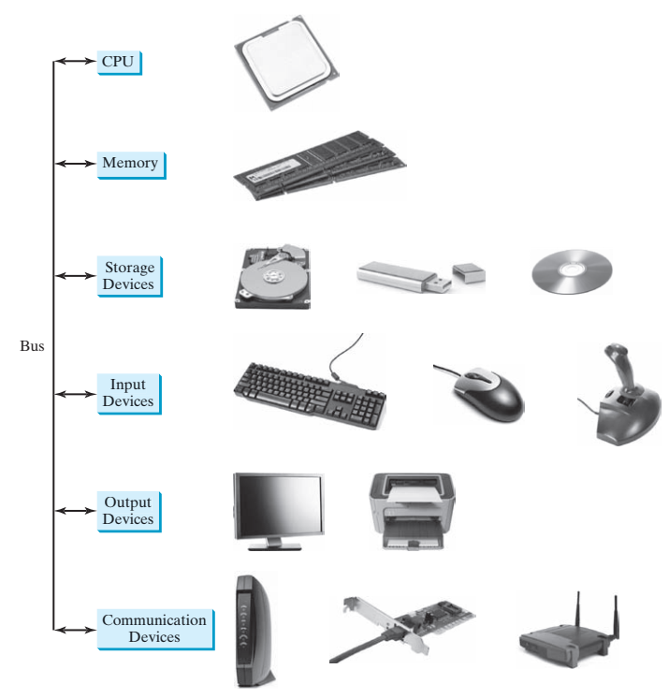
Hardware Components
Central processing unit
Memory
Storage devices
Input devices
Output devices
Communication devices

Slide 4
Central Processing Unit
Retrieves instructions from memory and executes them
Two components
Control unit
Arithmetic / Logic unit
Built from millions of transistors
Internal Clock
Used to control and synchronize the pace of operations
Clock Speed Unit (hertz)
Number of Cores

Slide 5
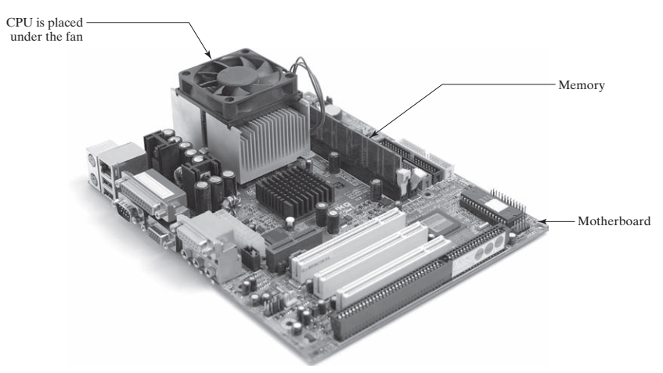
Central Processing Unit

Slide 6
Bits and Bytes
How data and program is stored in a computer?
Set the series of switches On or Off
On translates to 1 and Off translates to 0 (binary number system)
Byte
Minimum storage unit
8 bits form a byte
Data Encoding
encoding scheme is a set of rules that governs how a computer translates characters, numbers, and symbols into data the computer can actually work with (bits)
ASCII: C translates to 01000011
Memory units
KB, MB, GB, TB is approximately 1000, 1 million, 1 billion, 1 trillion

Slide 7
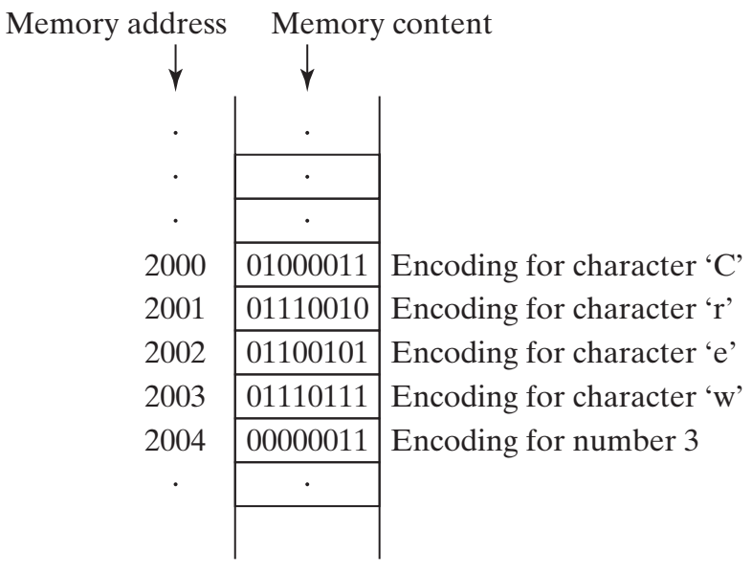
Memory
Computer’s work area for executing a program e.g RAM
A program and its data must be moved into the computer’s memory before they can be executed by the CPU
Every byte in the memory has a unique address
Slower and less
expensive than
memory available
in CPU

Slide 8
Storage Devices
RAM is volatile
Data is lost when power is off
Permanent storage elements?
Hard disk
CD / DVD
Flash drive
Programs and Data are store in permanent storage
Moved to memory for processing

Slide 9
Input and Output Devices
Keyboard
Mouse
Monitor
Printer
Touch-screen?

Slide 10
Communication Devices
Dial-up Modem
DSL
Cable Modem
Network Interface Card
Wireless Network Adapter

Slide 11
Programming Languages
Computer programs, known as software, are instructions that tell a computer what to do
Computers do not understand human languages; so programs must be written in ……?
Machine Language
Native language
Differs from computer type to type, generation to generation
A set of built-in primitive instructions
Instructions are in binary code
e.g 1101101010011010

Slide 12
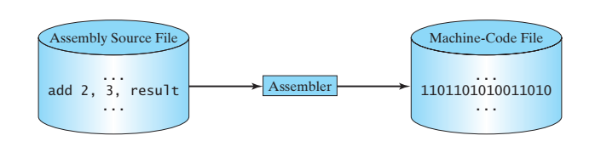
Programming Languages
Assembly Language
Alternative to machine language
Short descriptive words called mnemonic
e.g add, sub, mov, jump
Easy for humans but difficult for computers. Why?
Assembler translates assembly programs into machine code
Still tedious
An instruction in assembly language essentially corresponds to an instruction in machine code
Low level language and machine dependent

Slide 13
Programming Languages
High-Level Languages
Emerged in 1950s
Platform independent
English like syntax
Instructions are referred as statements
program written in a high-level language is called a source program or source code
Compiler translates source code to machine code.
Compiler vs Interpreter

Slide 14
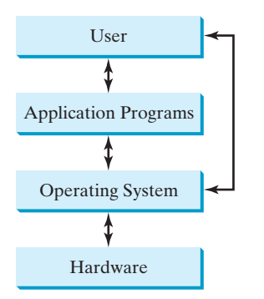
Operating Systems
Manages and controls a computer’s activities
Major Tasks
Controlling and Monitoring System Activities
Allocating and Assigning System Resources
Scheduling Operations
Multiprogramming
Multithreading
Multiprocessing

Slide 15
History of C++
C evolved from B which evolved from the BCPL
Basic Combined Programming Language, 1960s
BCPL: writing operating systems and compilers
B: used to create early versions of the UNIX
Both BCPL and B are typeless
every data item occupies a fixed-length “word” or “cell” in memory
C: Dennis Ritchie extended the B language by adding types and other features in 1971 to develop the UNIX operating system. Today C is widely used for developing operating systems.
C++: Extension of C, supports classes and OOPs
C++98 created by ISO. Why standardization?
C++11, C++14 and C++17 – Basics remains same

Slide 16
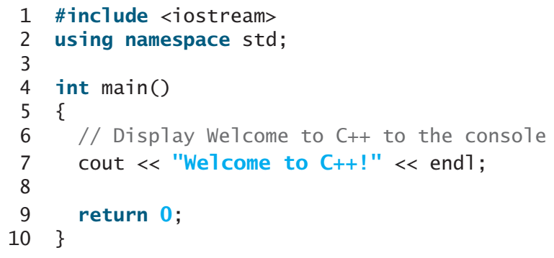
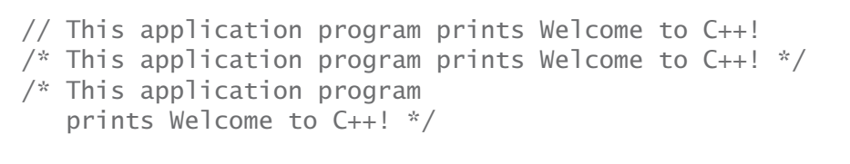

A Simple C++ Program
Preprocess directives are not statements (no semi-colon ;)
Extra space in < >
Case Sensitive
Main vs main

Slide 17
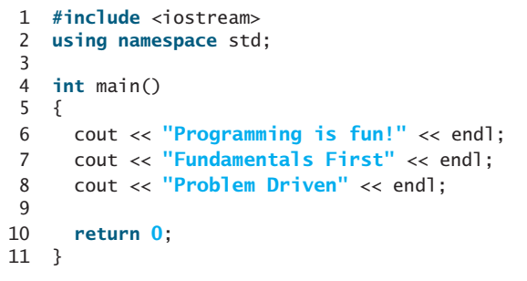
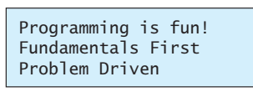
Listing 1.2
Output?

Slide 18
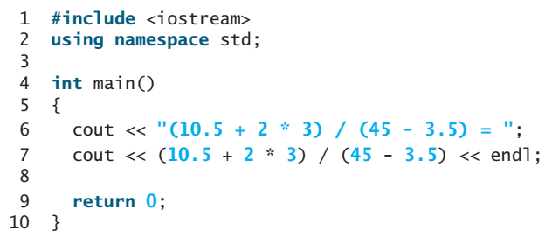

Listing 1.3
Output?

Slide 19
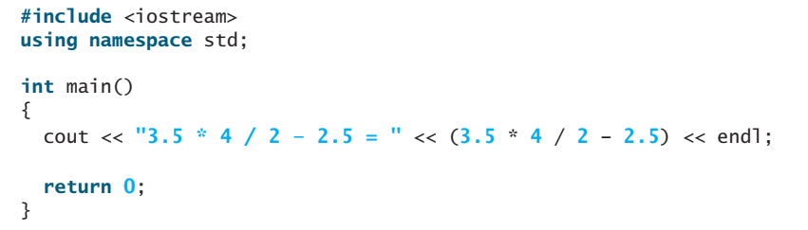
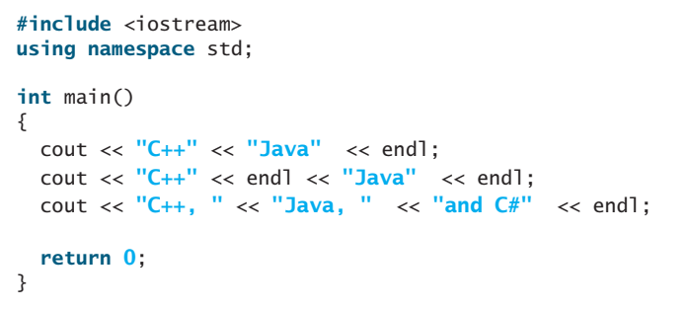
Output?

Slide 20
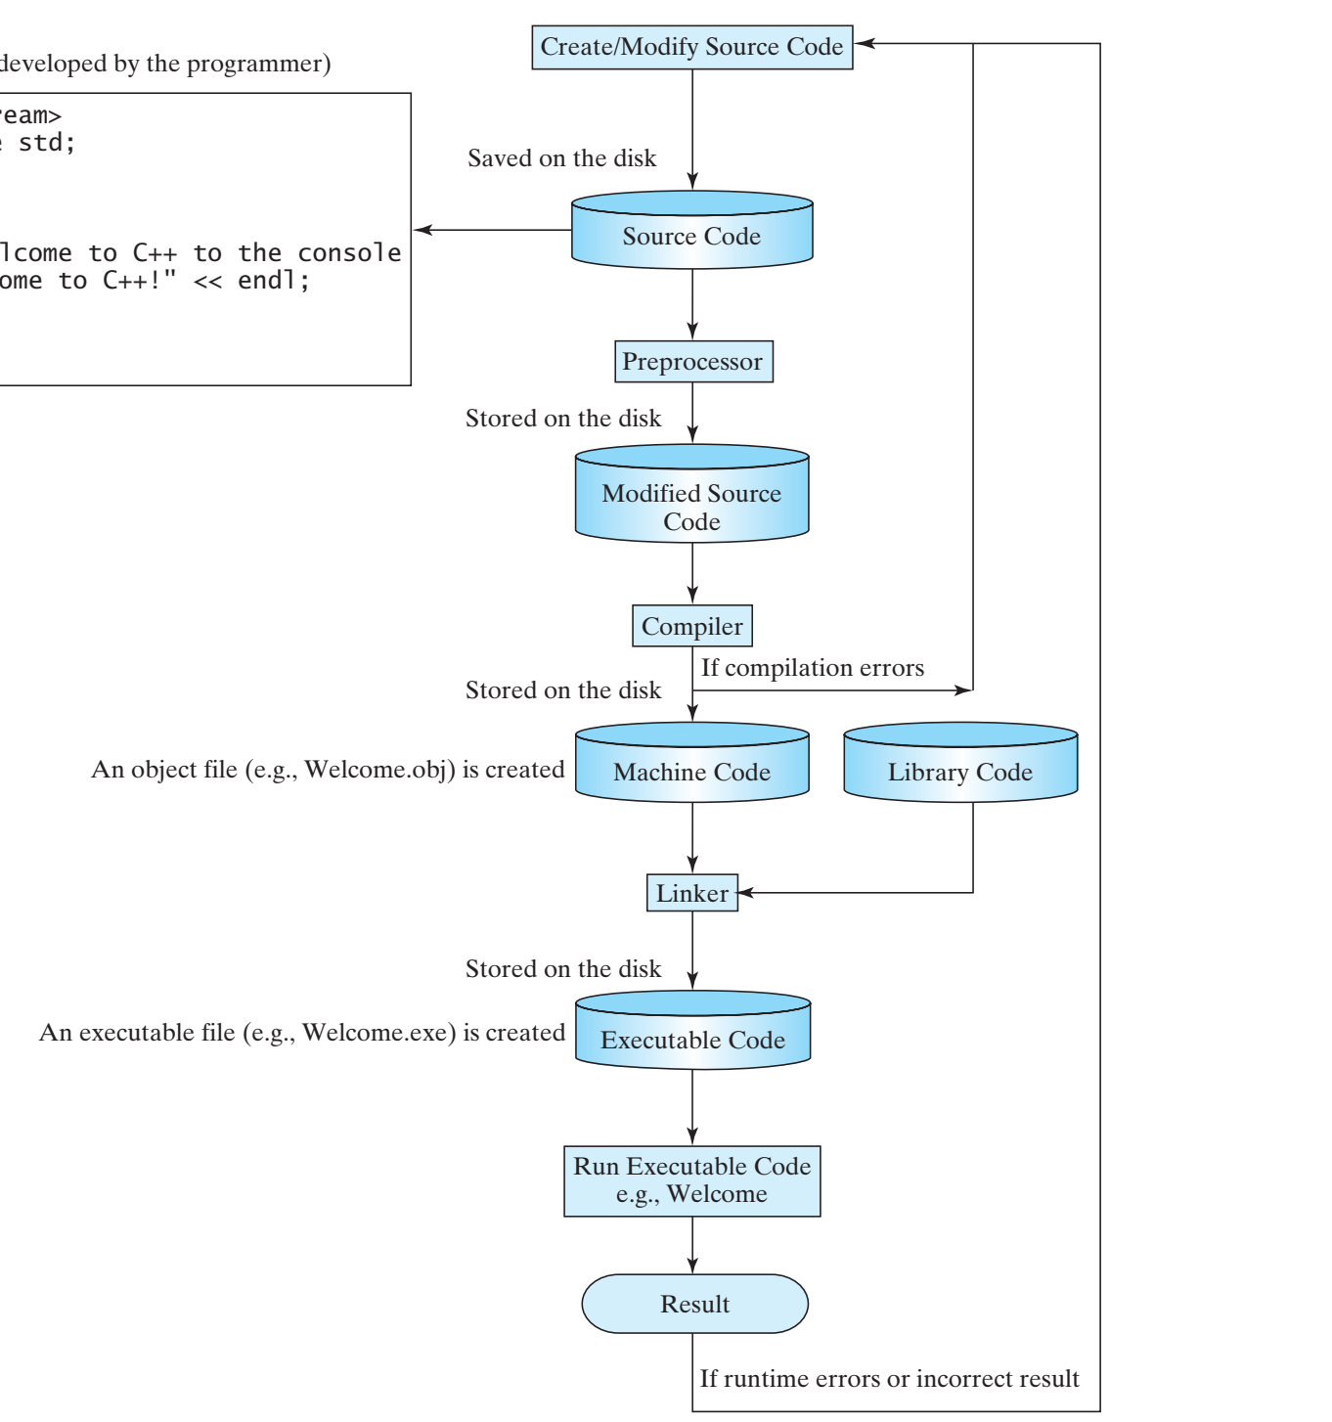
C++ Program Development Cycle

Slide 21
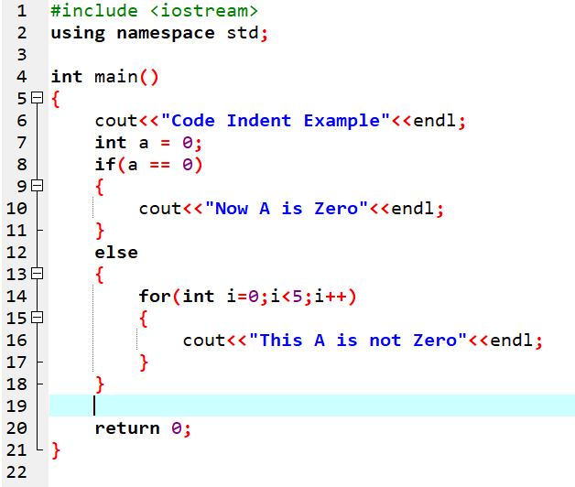
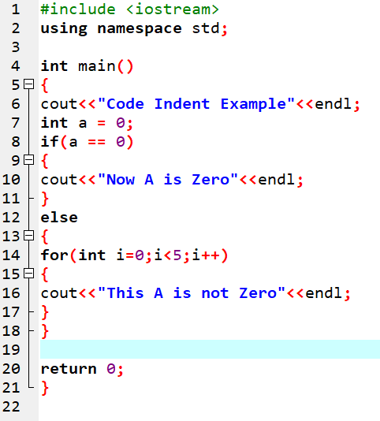
Programming Style and Documentation
Appropriate Comments
Comment Styles
Proper Indentation and Spacing

Slide 22
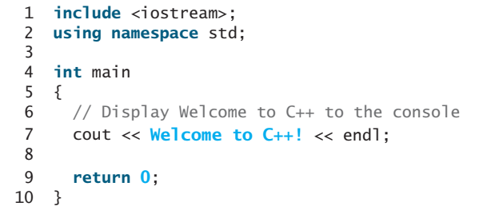
Errors?

Slide 23
Programming Errors
Syntax Errors
Runtime Errors
Logic Errors

Slide 24
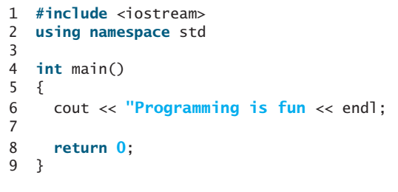
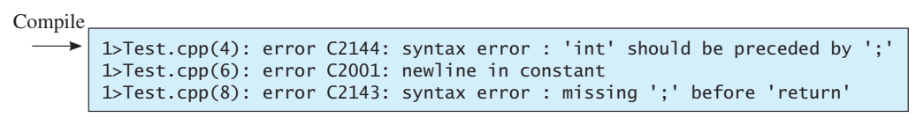
Programming Errors
Syntax Errors
;

Slide 25
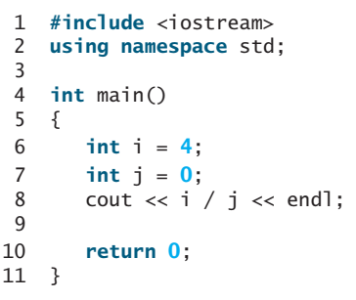
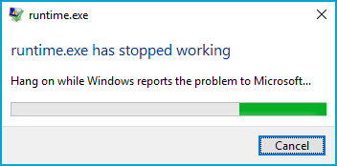
Programming Errors
Syntax Errors
Runtime Errors

Slide 26
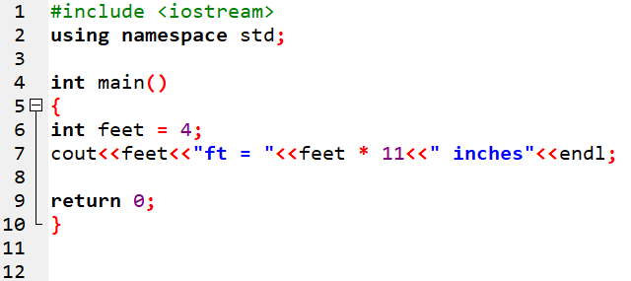
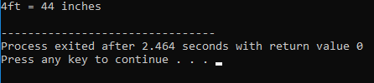
Programming Errors
Syntax Errors
Runtime Errors
Logic Errors

Slide 27
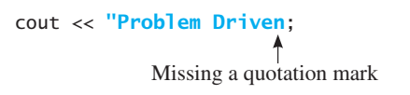
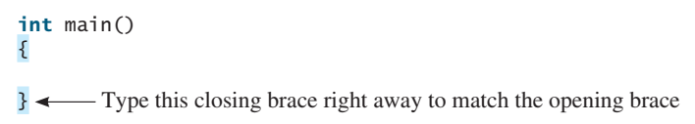
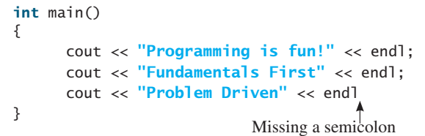
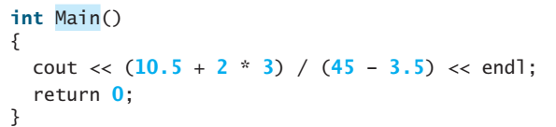
Common Errors
Missing Braces, Semicolons, Quotation Marks and Misspelling Names

Slide 28
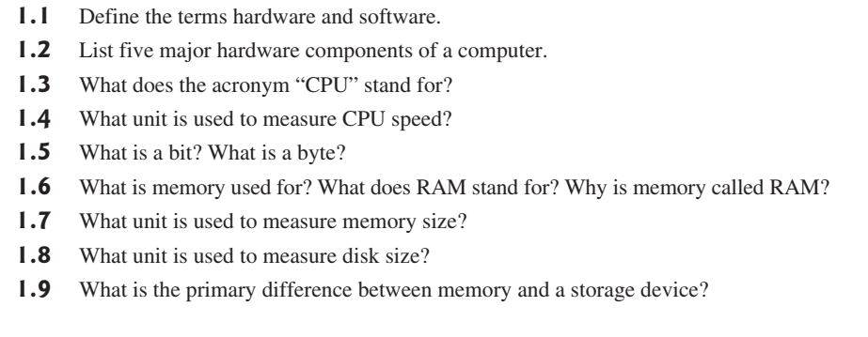
Work…

